Slide 1


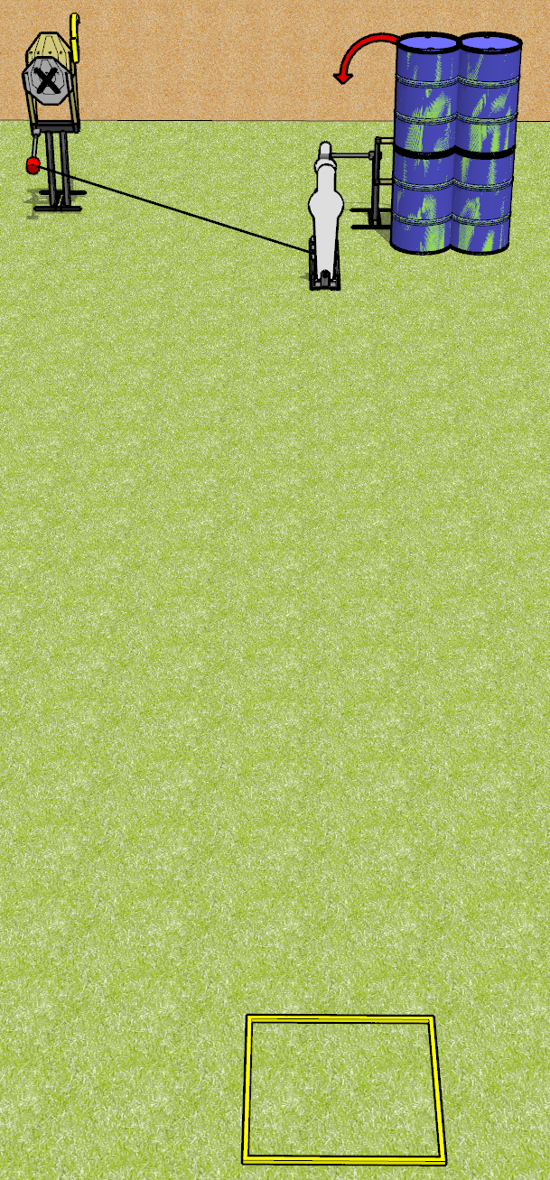
 | Dothan Gun Club – USPSA Match Just For Fun Course Designer : Drew Coleman
Round Count 8 Rounds 2 IPSC 1 pepper, 1 mini
Equipment List Max trap + activator Swinger Shooting box

Slide 2
Just For Fun
Written Stage Briefing
Just For Fun is an 8 round, 40 point, Comstock speed shoot. There are 2 IPSC targets and 2 steel. The best 3 hits on cardboard will score and steel must fall to score.
The max trap is activated by P1 and is a disappearing target. The swinger is activated by P2 and remains visible at rest
Handgun start position is anywhere inside the shooting area, wrists below belt. Handgun is loaded and holstered.
PCC start position is anywhere inside the shooting area, stock on belt. Loaded carbine is held with both hands, safety on.
On the audible start signal, engage targets as they become available from within the shooting area.

